Slide 1
How to Control
Arduino LED from Unity

Slide 2
Before you Start…
Ensure you have followed the steps in the Setup Guide
Unity installed
Ardity package installed & set up
Arduino IDE installed & set up

Slide 3
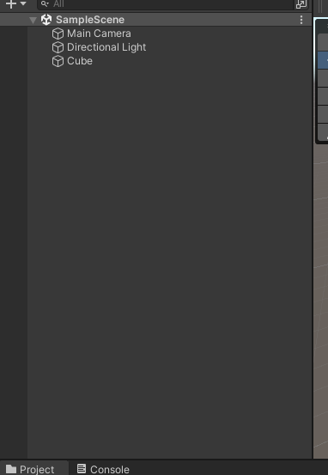
Creating an Object
Right click on the Hierarchy area on the left
Create a new Cube 3D object
3D Object > Cube

Slide 4
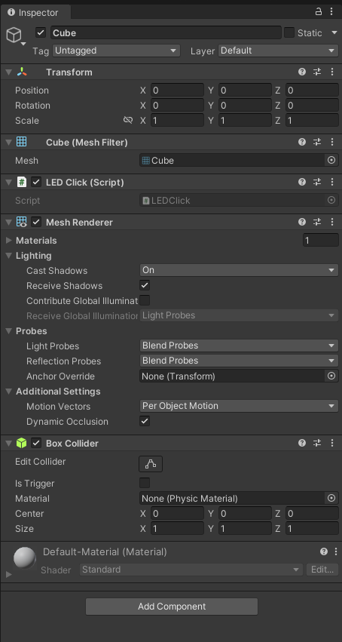
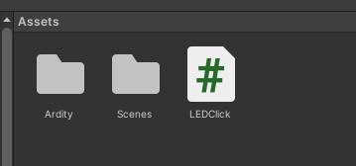
Adding Code to the Cube
Download “LEDClick.cs”
Add into your project Assets Folder
Click on the Cube object
Drag the code file into the space on the right

Slide 5
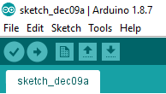
Arduino Code
Download & open Sketch dec9a.ino
Upload the code into your Arduino
Ensure you go to Tools and select the correct port and board type

Slide 6
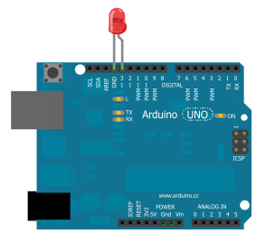
Arduino Circuit Setup
Plug the longer end of the LED into Pin 13
Plug the shorter end into GND (Ground)
Notes:
http://www.learningaboutelectronics.com/images/Arduino-LED-flasher.png

Slide 7
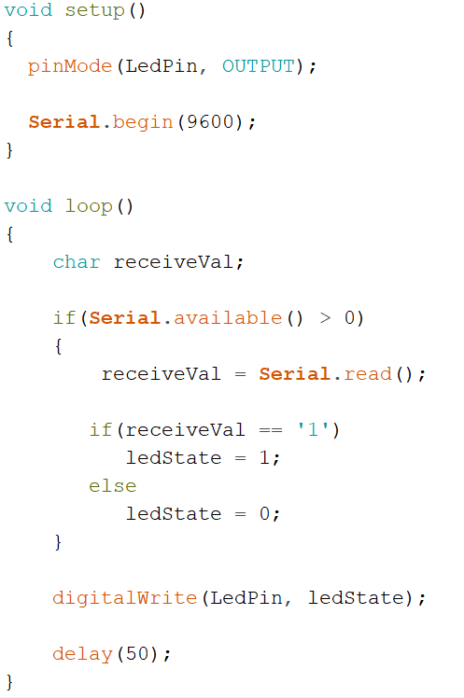
More about the Arduino Code…
Setup
Sets pin 13 to output mode
Begins serial clock at 9600 Baud Rate
Loop
If the serial port is open, read the data from the port
If the value received is “1”, sets variable “ledState to 1”
Else, ledState remains as 0
Writes the value of ledState to Pin 13
This will turn the LED on or off accordingly
Wait for 50 milliseconds

Slide 8
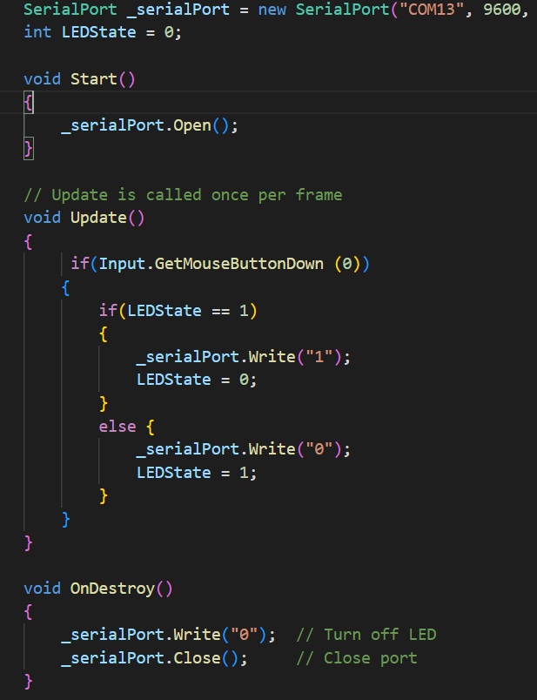
More about the C# Code…
Declaration of Cube object and Serial Port object set to port 13 at 9600 Baud rate (same as Arduino)
Start
Opens serial port (set serial port according to your computer)
Update
If a left click input is detected:
Check if variable LED state is at 1 or 0
If the LED is off, writes “1” to serial port (recall that the Arduino code checks for this “1”, and changes LEDState to 0
The purpose of LEDState: the next time we left click, we want the LED to turn off. Hence the variable stores the next intended action for the LED
Void Update() is called repeatedly in Unity
OnDestroy
When the application stops running (you exit Play mode),
Turns off LED by writing “0”
Closes serial port

